Slide 1
LEDCOR - SICIM
Planning, Asset, & Logistic Application
Notes:
Cover Page: title of the entry and name of the company

Slide 2
ACHIEVEMENTS
Increased equipment efficiency by 27.54%
Collation of 73 unique forms that were previously managed independently.
Over 1000 active users obtaining benefits.
An average of 471 form submissions per day.
Expedited workflow between the client and contractors.
Easy setup and updates of software ensures revisions are updated quickly and frequently, providing a better experience for application users based on feedback received.

Slide 3
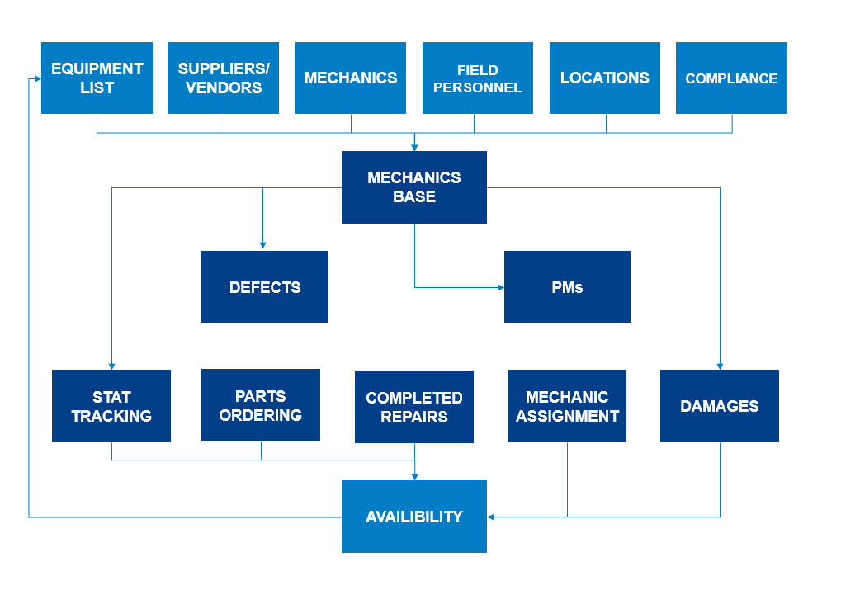
ACHIEVEMENTS
Updated input fields
Revised dispatch requests
Stages of completion
Better access to information
Dispatch to a single mechanic
Reassignment based on personal availability, priority, or location
Unlimited potential for further discipline integration.
Above flow chart illustrates a solution for one discipline

Slide 4
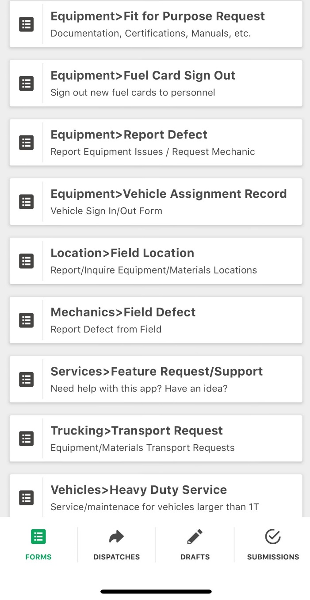
COORDINATION IMPROVEMENT
MANUAL PROCESS REDUCTION
DATA COLLECTION & REPORTING
EXTERNAL COMMUNICATION
INSTANT NOTIFICATION
LOGISTICS OPTIMIZATION
OFFLINE CAPABILITY
EXPEDITED REQUESTS
EFFICIENCY INCREASES
SYSTEMS INTEGRATION
LOGISTICS MANAGEMENT
MANDATORY TEXT FIELDS
WAREHOUSE ORDERING
INVENTORY MANAGEMENT
STANDARDIZATION
CENTRALIZED DATABASE

Slide 5
A. Does it provide the pipeline construction industry with something it did not have before?
The high level of accuracy created by mandatory text fields, coupled with offline capability and reach to non-application users, as well as multiple user-friendly features, provides a new industry standard for field task planning, asset management, and logistics operations.
B. Does it constitute an identifiable step forward in the technology/construction process?
Increasing effective communication internally and externally, with both clients and subcontractors, have been quantitatively demonstrated to improve productivity and lower cost, which are measurable improvements to prior construction processes.
C. Does it improve safety and/or environmental protection?
Delivers time-sensitive safety information to their recipients, while simultaneously reporting the information to 2nd and 3rd tier recipients. Uses GPS location settings to manage environmental features such as bird nesting and active amphibian locations. Tracks completion of environmental corrective actions.
D. Does it overcome a current problem area in pipeline construction?
Miscommunication due to a lack of detailed information provided, poorly transcribed information collection, lack of reliable cell phone coverage, and general forgetfulness, are issues that the pipeline industry has had for many years. This application has provided a solution to these problems by: 1) Creating mandatory text fields 2) Providing verbatim information from sender to receiver 3) Providing offline cellular capability options that removes the opportunity for forgetfulness being forced to send information later. The application has demonstrated its effectiveness on this large scale project and will be equally as effective on small and medium sized projects alike.
E. Does it provide a reason to change the manner in which pipelines are installed?
The app is a solution to many small issues that arise in daily processes. It operates as a catalyst to drive efficiency and organization within field task planning, asset management, and logistics operations. These benefits have a positive impact on cost and schedule which provides reason for broader industry adoption.
F. Does it have additional benefits?
We are consistently and continuously finding new ways to integrate manual, error prone tasks that have administrative burden potential into a more efficient process through the use of the application.
Notes:
61 +

