Slide 1
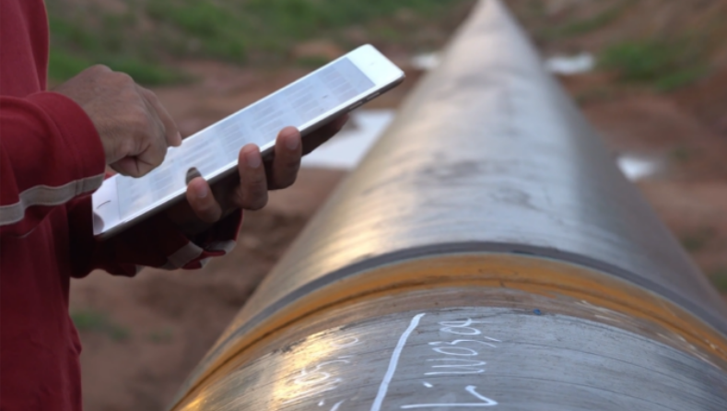
Digitized pipeline construction monitoring with QCM
« Innovating for quality, health and safety, and the environment - that's LogIC »
www.logic-sas.com

Slide 2
Mobile application for pipeline construction monitoring
Main objective : Optimize construction progress monitoring and control of quality requirements
From the reception of the pipes to the excavation of the structures, each phase is monitored, controlled, and traced
Used by field teams and project management, on-site or remotely
Allows real-time monitoring of construction progress and compliance
Allows for automatic and instantaneous editing of self-checks and feeding of the weld logbook
Designed with a simple and operational approach based on our experience alongside construction companies and clients, this application, designed by us, is developed for you!

Slide 3
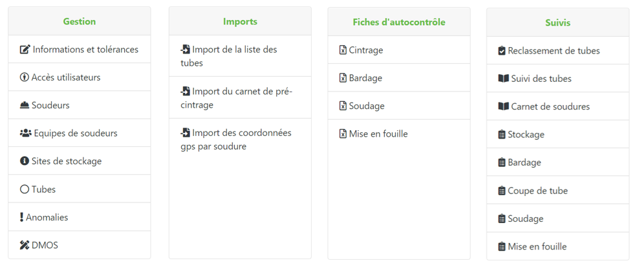
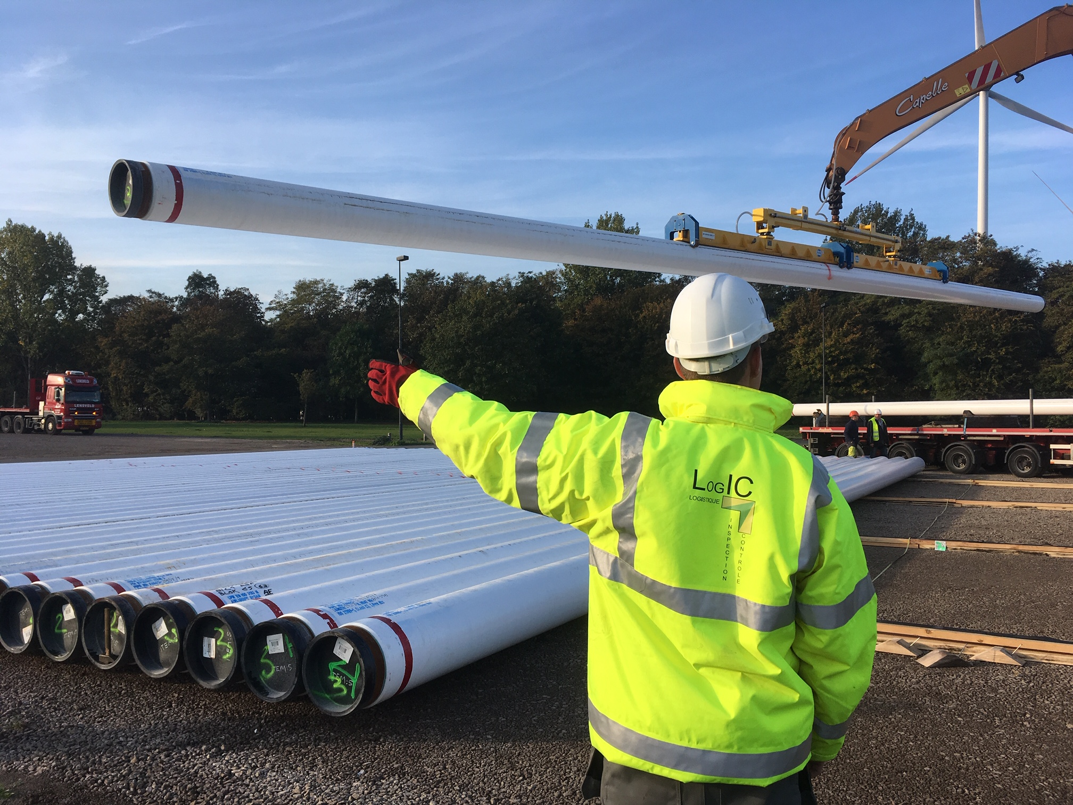
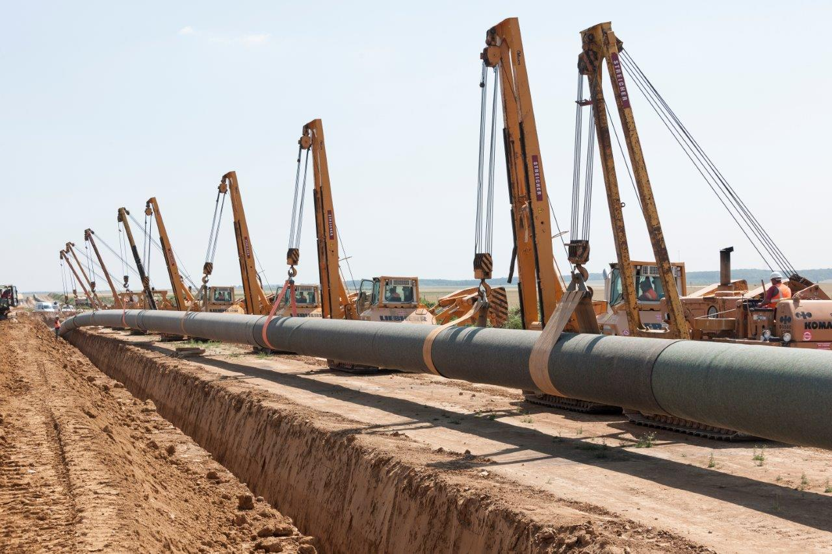
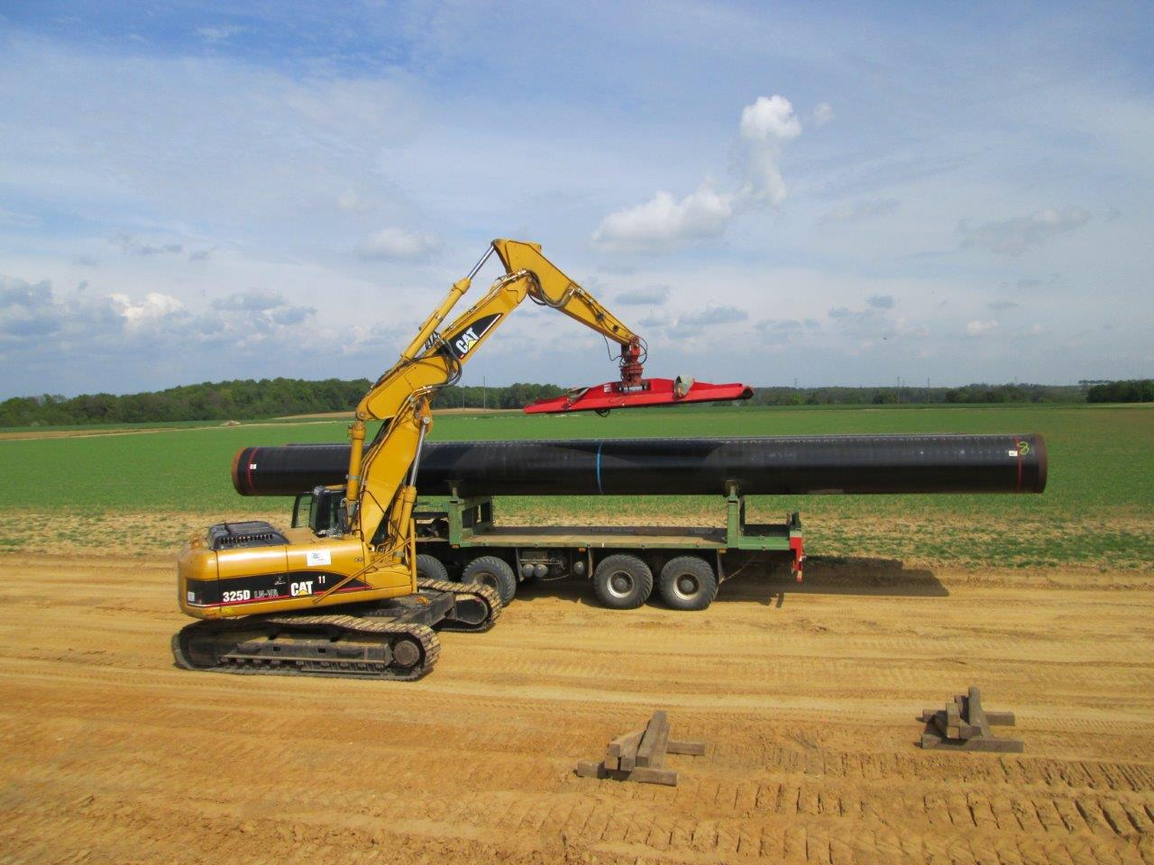
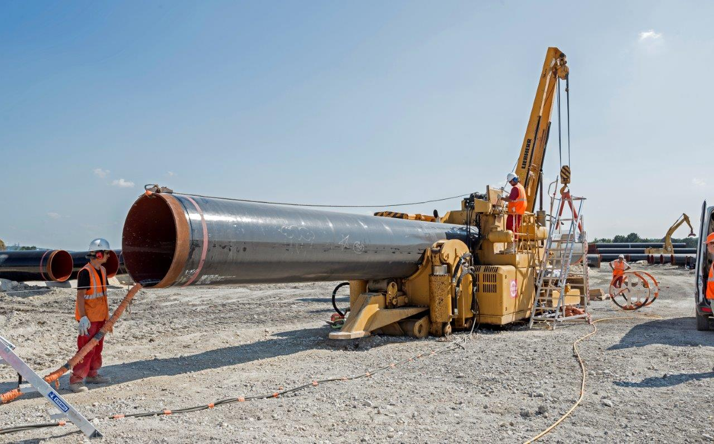
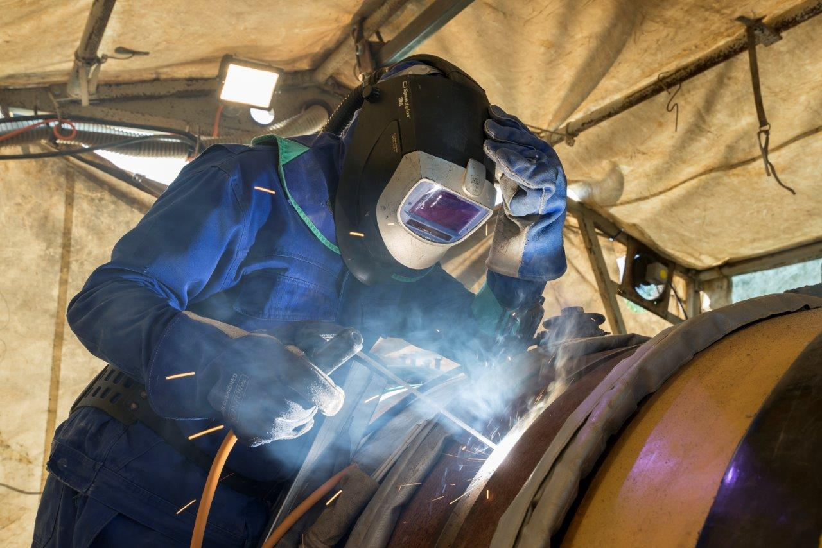
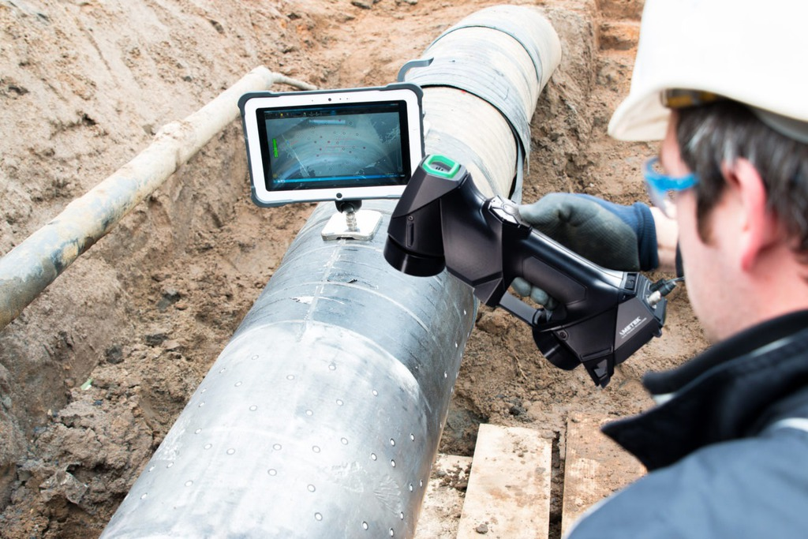
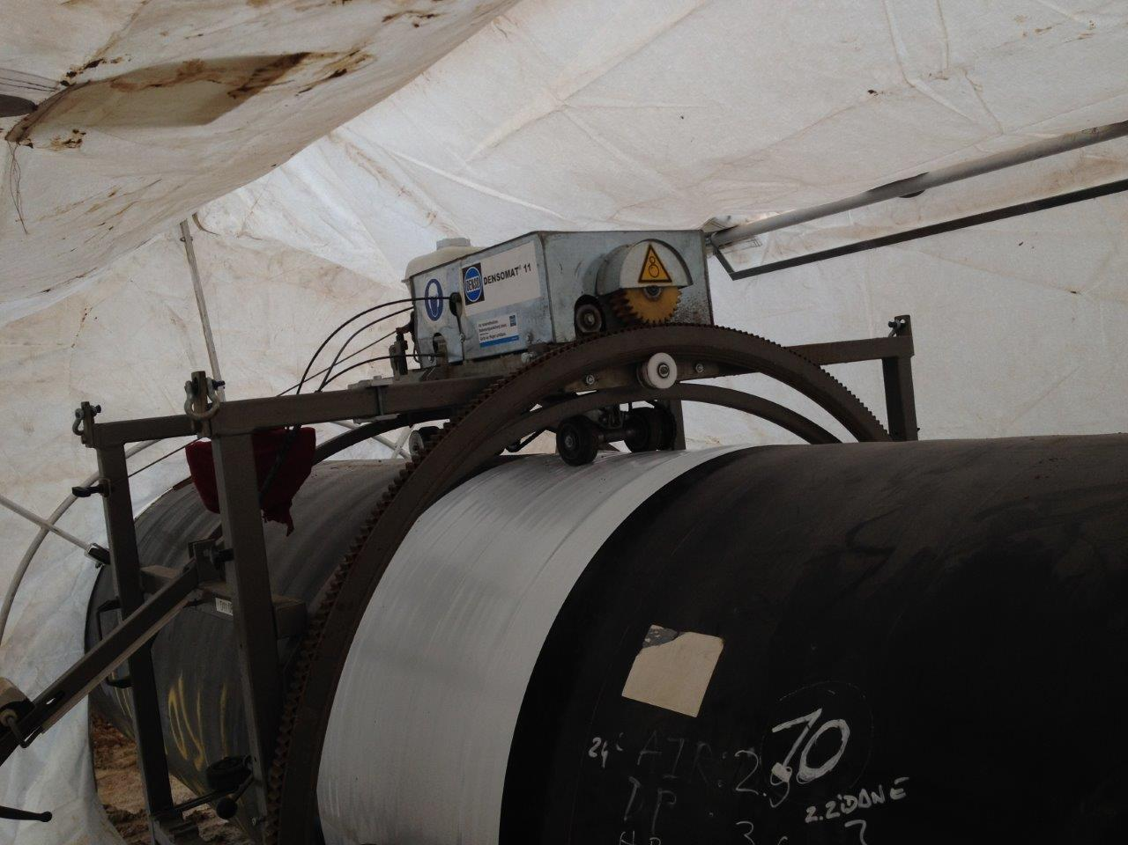
Operating principle
Site configuration :
List of pipes
Pre-bending logbook
Requirements and tolerances
Material and human resources
Required documents editing :
Progress reports
Self-checks
Weld logbook
Balance sheets
Q.C.M.
Centralization and control of data
Storage
Lowering in
Instant, two-way data flow
Stringing
Bending
Welding
NDT
Coating
construction data recording on-site

Slide 4
Advantages
With QCM, construction data and information are monitored, recorded, and shared in real-time
Better accessibility of data
Real-time management
Improved processing times
Centralization and archiving of projects
Improved and optimized monitoring of the life of the structures
Less manual data processing
Reduced risk of errors
Improved processing times
Optimization of working time
Less errors
Improved quality of self-checks
Improved traceability of pipes and welds
Reliability of weld logbooks and test records
Time-saving
Less paper
Reduced risk of information loss
Reduction in paper and ink consumption
Improved quality of information feedback
Improved working conditions on the field
Less unnecessary trave
Reduced risk of road accidents
Reduction in fuel consumption
Improved working conditions

Slide 5
Optimization of time and deadlines
Working towards quality, health and safety, and environmental protection means adopting QCM !
Have the
click
Contact us
Julien BEAUFILS
Technical and Commercial Manager
Julien.beaufils@logic-sas.com
+33 (0)7 78 38 42 21
5 rue du Tertre, 44470 CARQUEFOU, Fr
Reduction of health and safety risks at work
Improvement of the quality of work life
Reducing environmental footprint
Quality control
Cost reduction
Securing and availability of data
LOGIC, SASU with a capital of 50000 € - 24 avenue Foch, 54270 ESSEY LES NANCY, FRANCE
APE : 7490B - SIRET : RCS NANCY N°75082104300023 – VAT number : FR48750821043

