Slide 1
Safe Driver Initiative

Slide 2
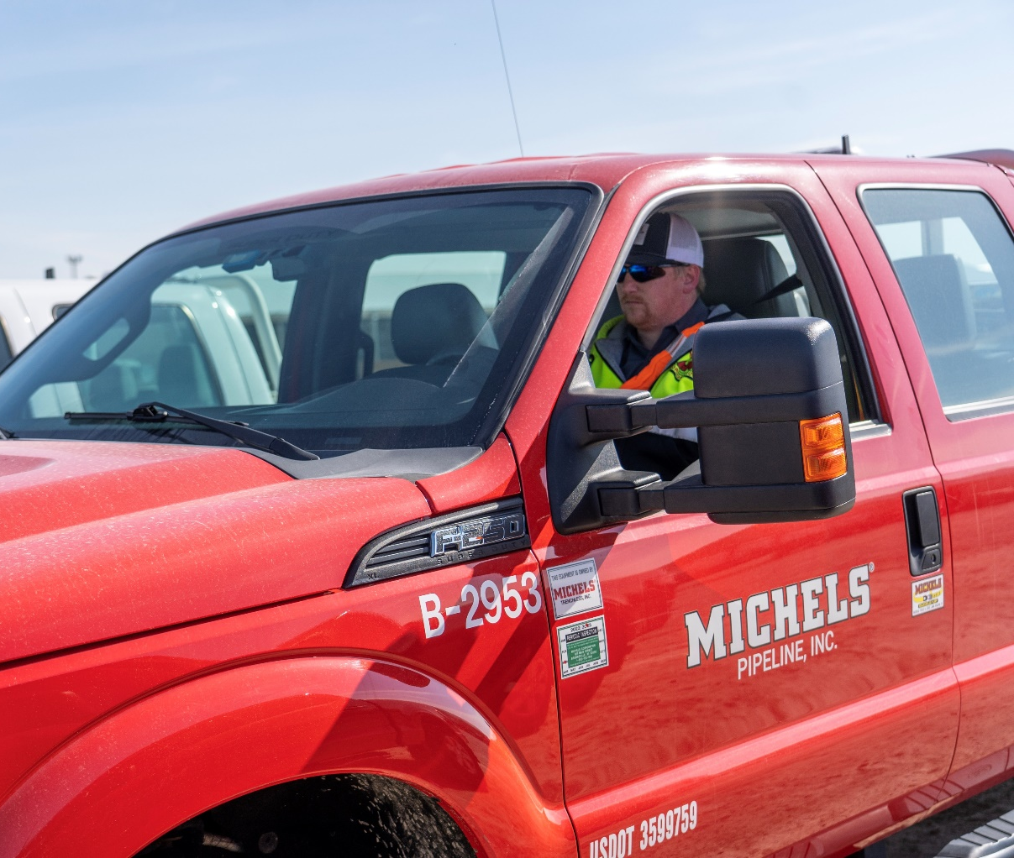
Initiative Background
Driving, one of the activities that every working group performs daily, has the most significant potential for a negative impact. We cannot eliminate the need to drive in support of our work, nor can we control the behavior of those we share the road with.
In 2022, the Michels Family of Companies totaled 60 million miles driven in our wide range of vehicles all across North America. The safety of our people and our positive brand identity depend on our ability to keep our drivers and roadways safe.
To reduce the risk of fatalities and severe injuries, and convey the importance of driver safety, We took a proactive step to create safer drivers by creating the multi-faceted Safe Driver Initiative.

Slide 3
Solutions & Implementation
Established by the Michels Family, Senior Leadership and Health, Safety and Environmental Team, this multifaceted program provides the training, tools and education needed to drive safely regardless of the situation or hazards.
Our initiatives are divided into three areas of focus:
Training
Driver Resources
Technology

Slide 4
Achievements & Strategic Planning
Training: In 2022, nearly 1,600 team members were trained on a variety of topics relevant to drivers in the field and at offices.
Driver Resources: A helpline was established to provide drivers with 24/7 answers to questions about compliance, vehicle troubleshooting, and for assistance with permits and other items. In 2022, more than 735 calls were received.
Technology: Michels installed 1,100 dash cameras in 25% of fleet vehicles to provide driver coaching and traffic event data. By 2024, dash cameras will be installed in every vehicle in the Michels fleet.

