Slide 1
EXCELLENCE IN QUALITY IPLOCA QUALITY AWARD

Slide 2
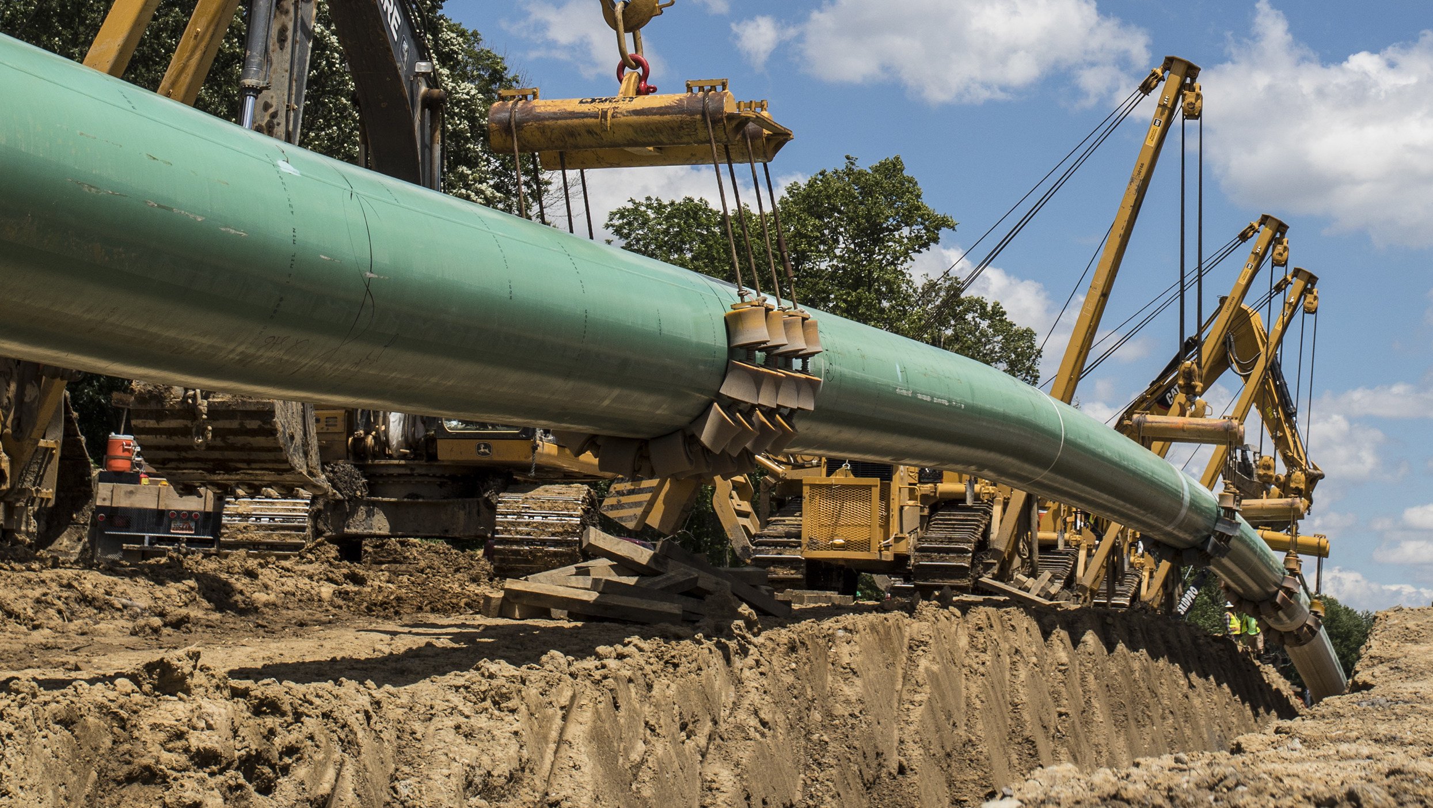
One Column Bullet List Goes Here
Established on the principle of meeting the needs of clients while maintaining a focus on safety, quality and environmental compliance with minimal impact to landowners.

Slide 3
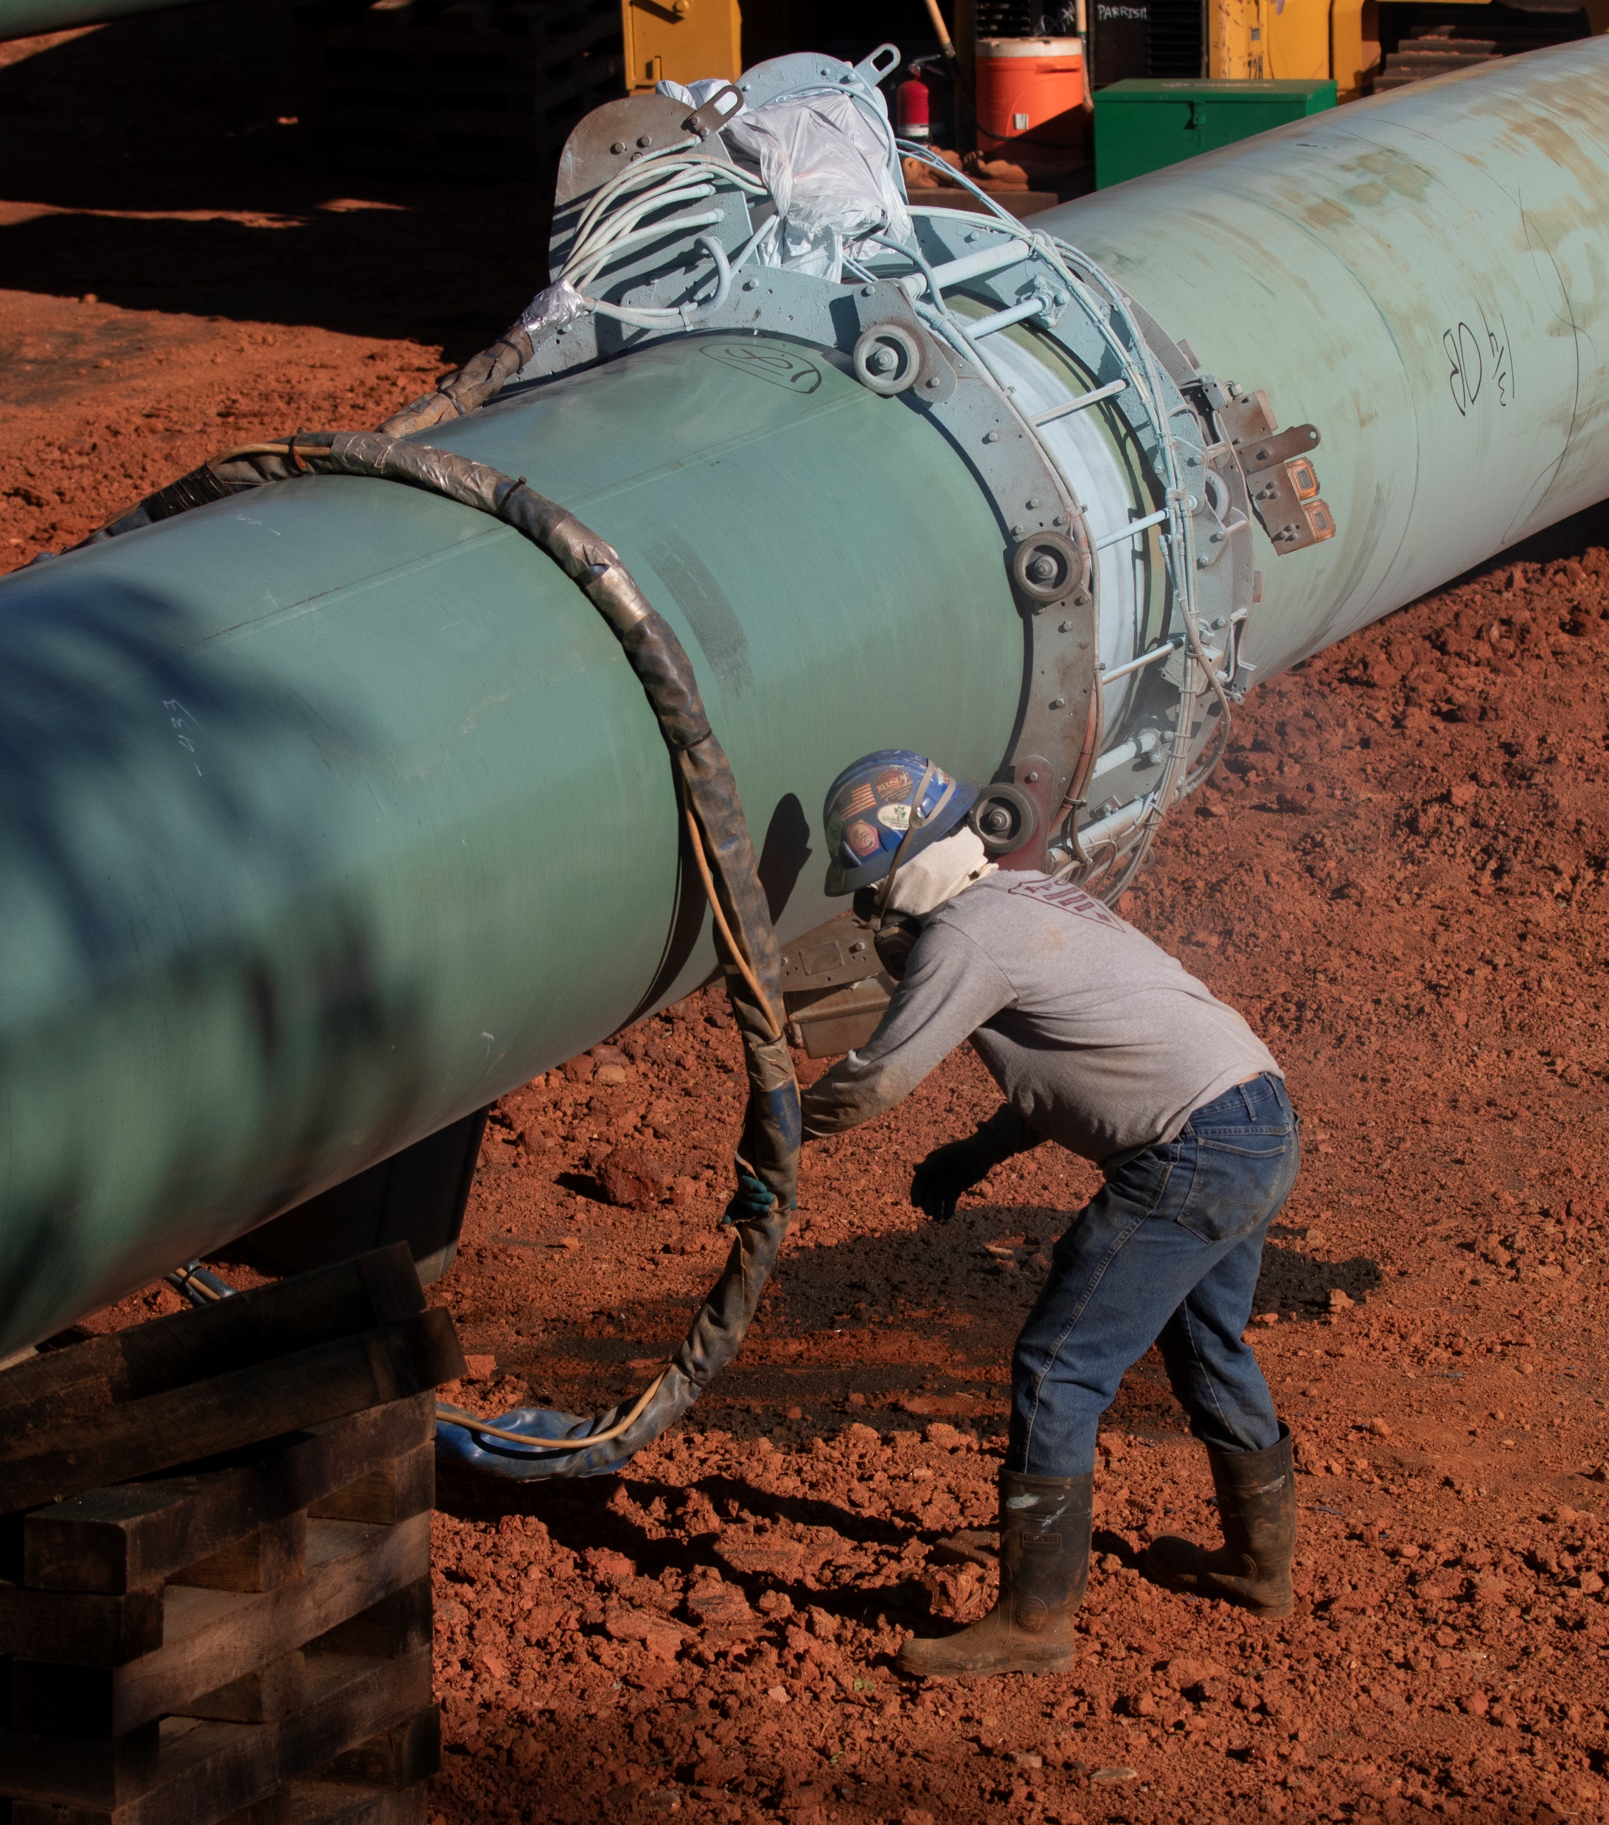
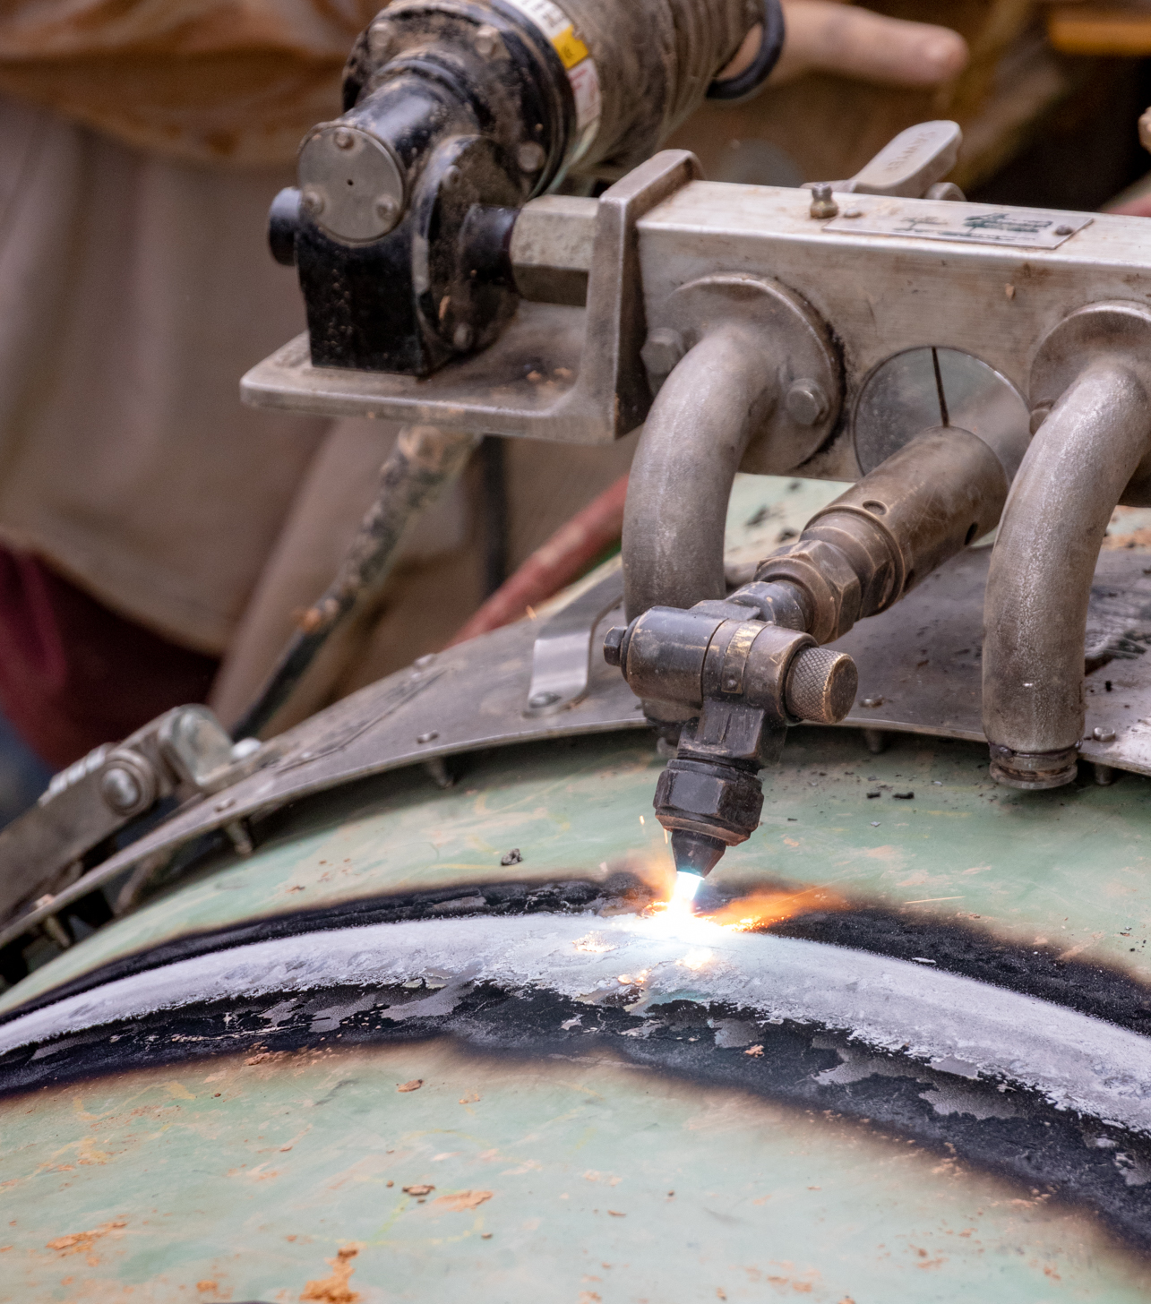
QUALITY MANAGEMENT SYSTEM
Overview
Plan, Do, Check, Act (PDCA)
Three (3) Pillars
Customer Focus
Process Approach
Risk-Based Thinking
ISO 9001:2015 Certified

Slide 4
QUALITY INSPECTIONS
Evolving Our Inspection Method
Manual Documentation
Hard copies of checklists & inspection forms
Inspections documented by hand
Deficiencies manually tracked
Reliant on field personnel to complete correctly and categorize properly
Dedicated personnel required to maintain documentation and perform deficiency tracking
Digital Documentation With Real-Time Results
Created digital inspection forms
Inspections performed on iPads
Automated tracking of deficiencies
Instant access to inspections
Conduct real-time reviews
Record retention
Readily accessible & searchable

Slide 5
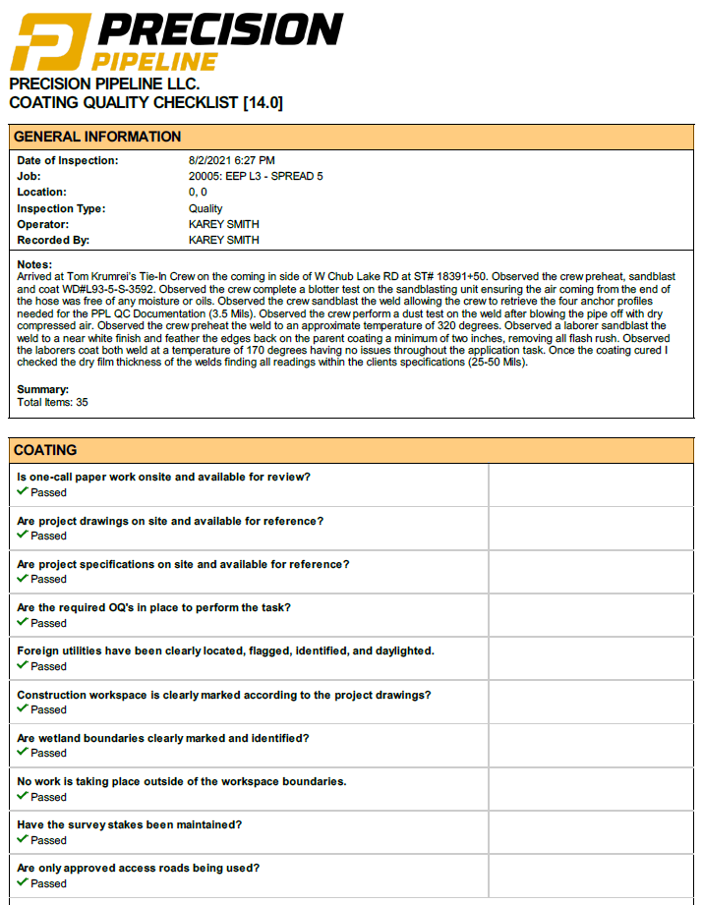
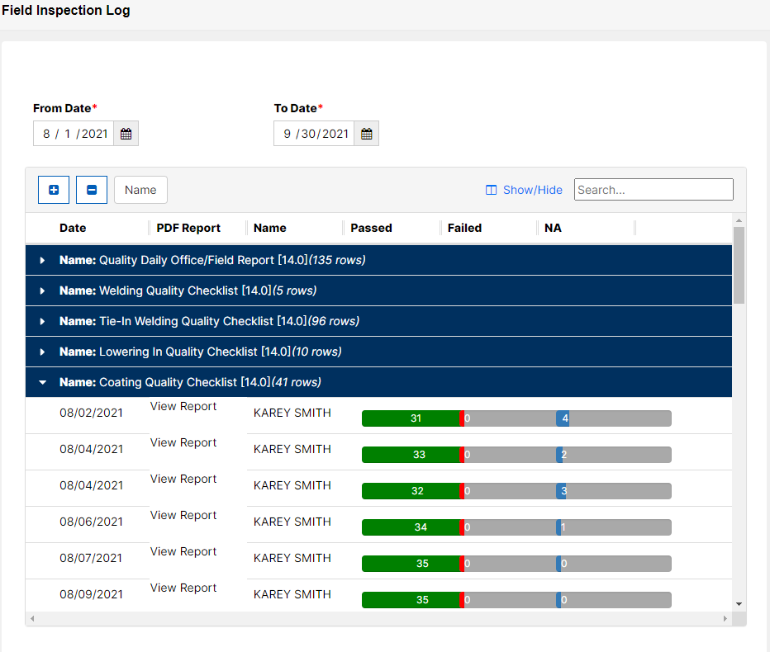
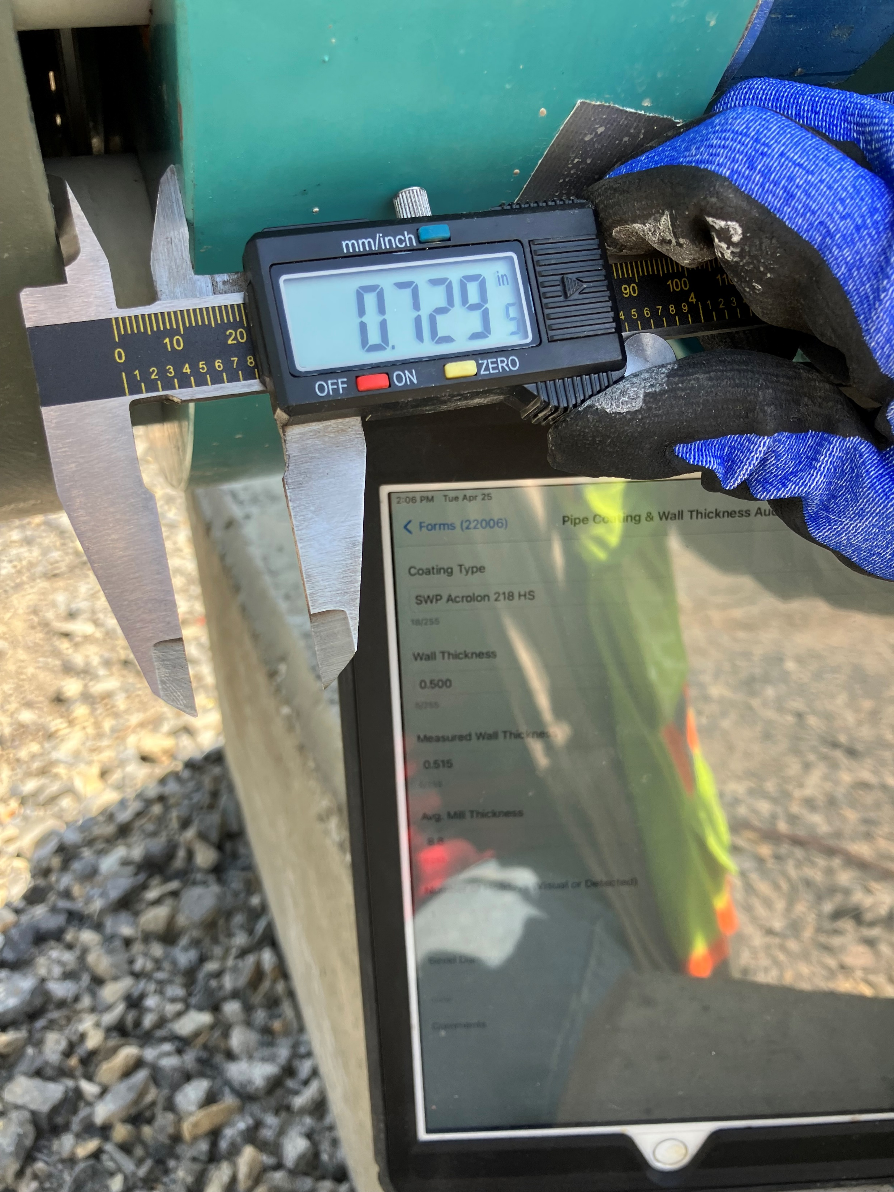
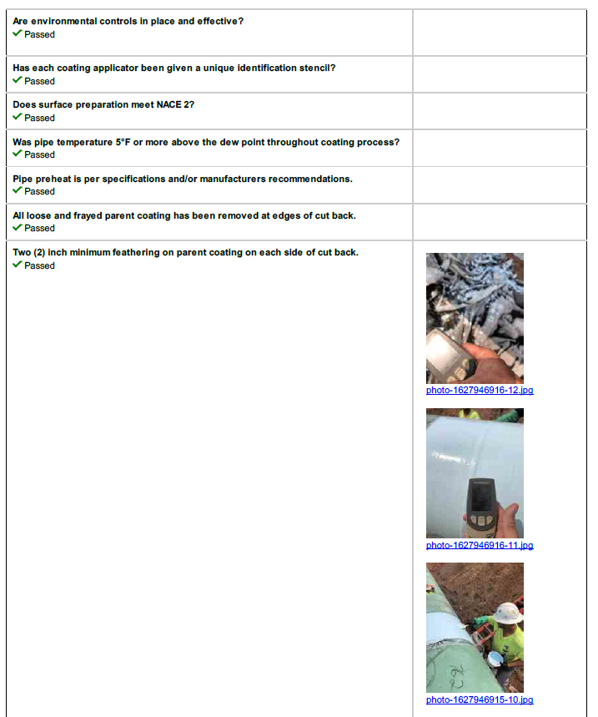
QUALITY INSPECTIONS
Data Collection & Digital Documentation

Slide 6
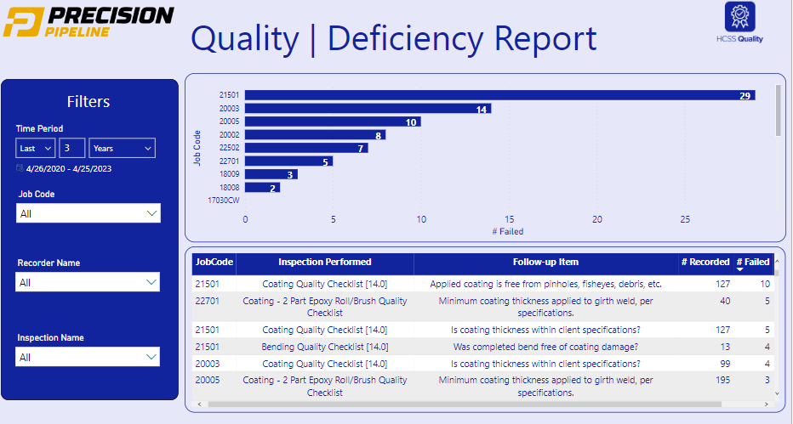
QUALITY ANALYTICS
Quality Dashboard
Real-time analytics
Review specific project or entire company
Identify types of deficiencies
Identify risks
Review non-conformances
Quick view on crew performance

Slide 7
PrecisionPipelineLLC.com

