Slide 1
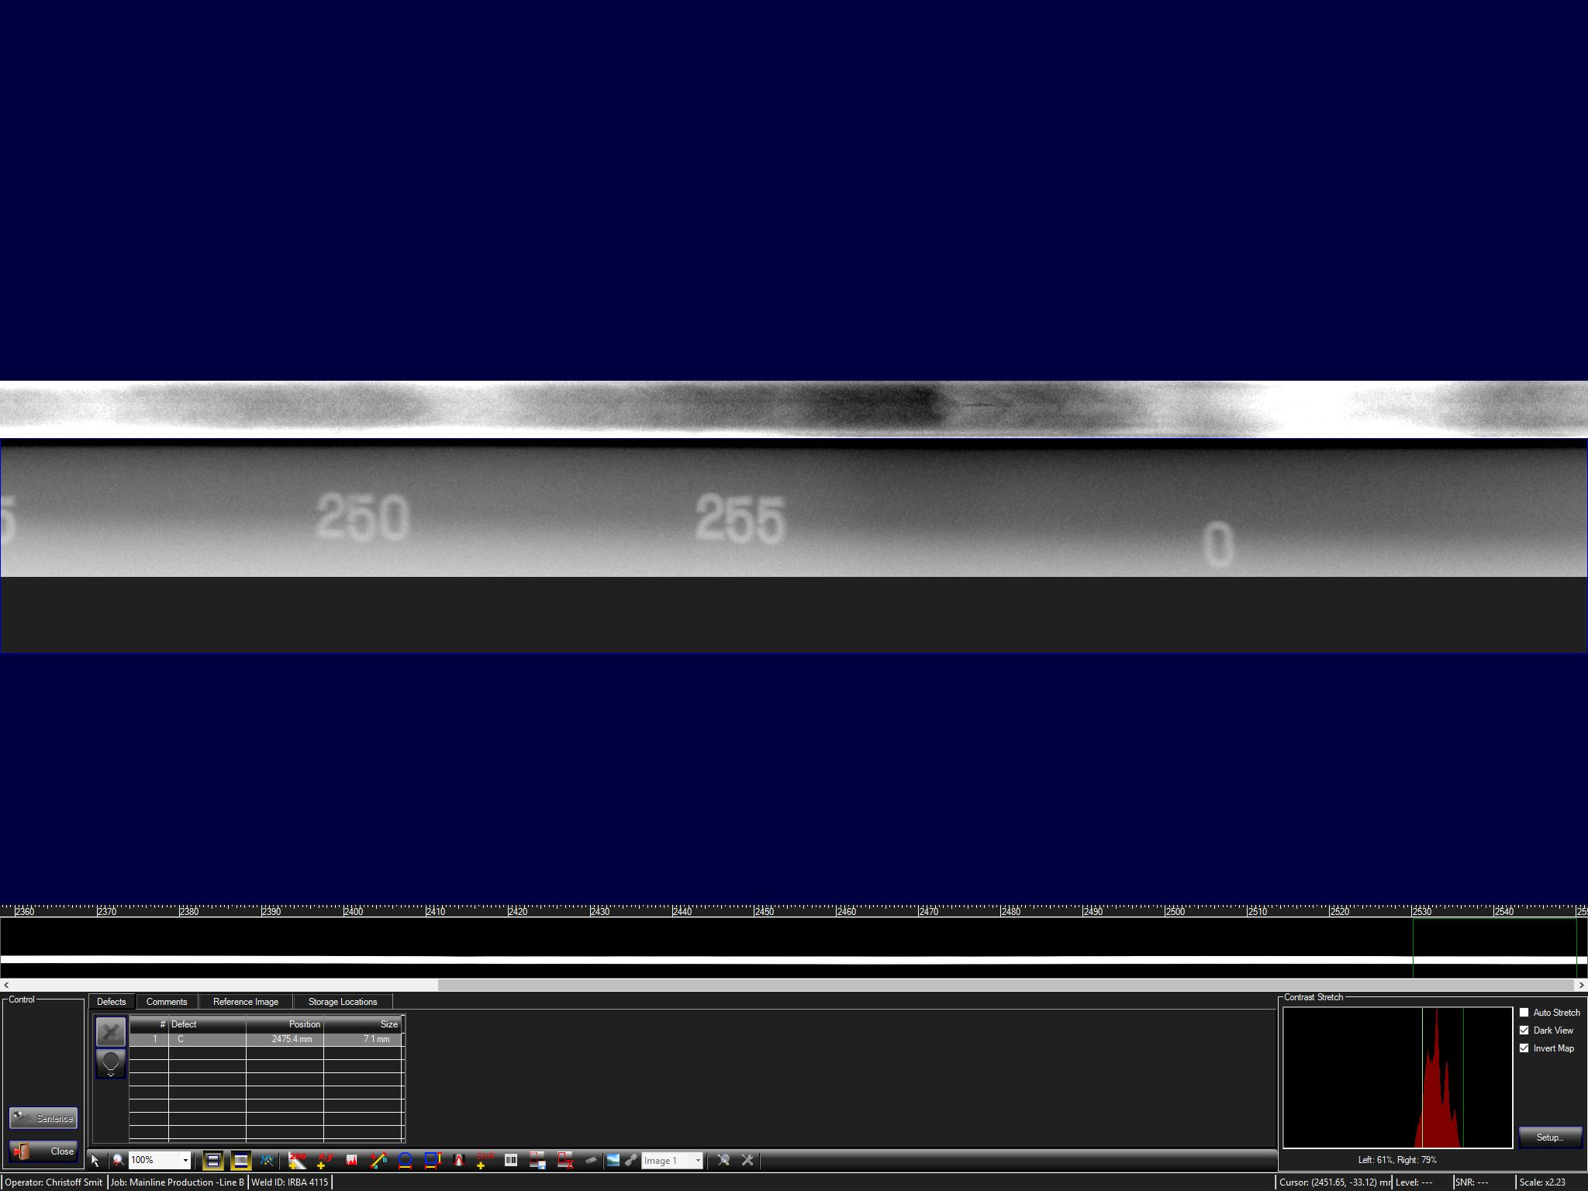
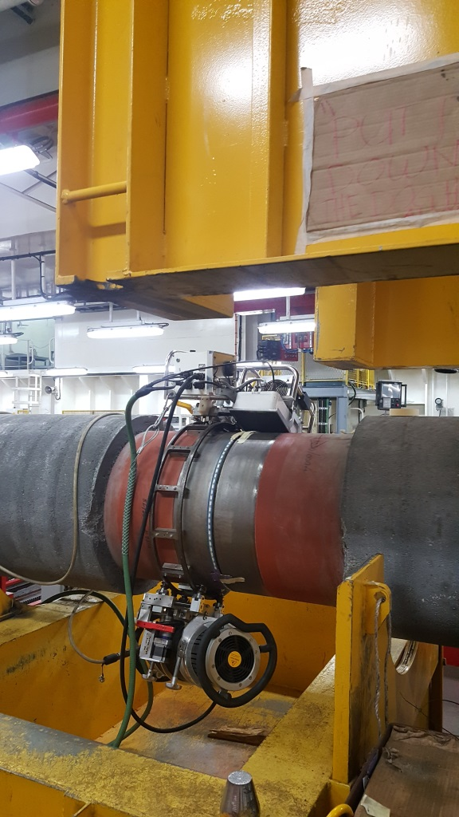
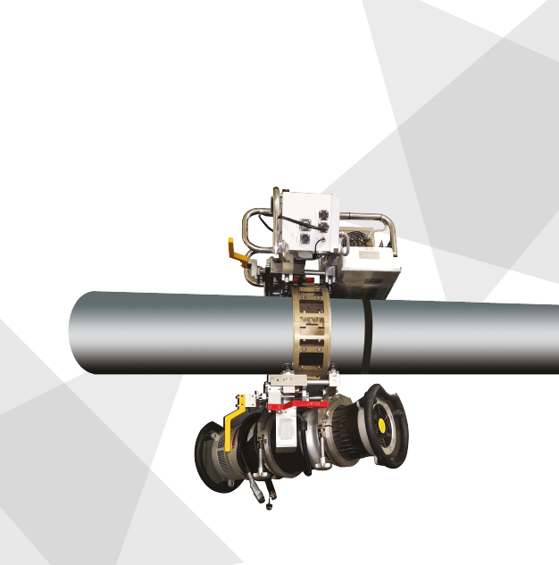

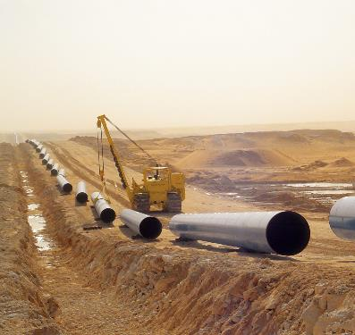
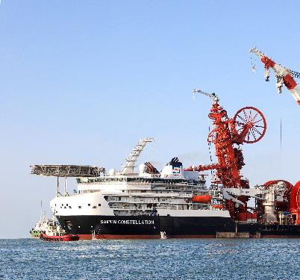
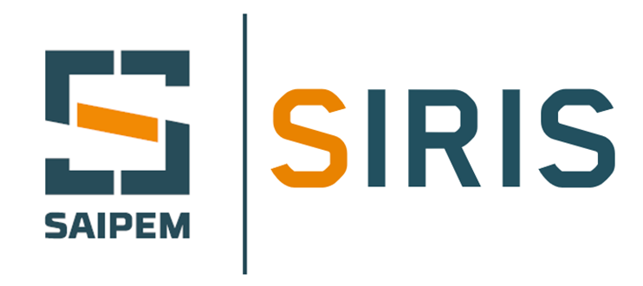
SIRIS – DIGITAL RT DNV QUALIFICATION
2023 – IPLOCA QUALITY AWARD
2023

Slide 2
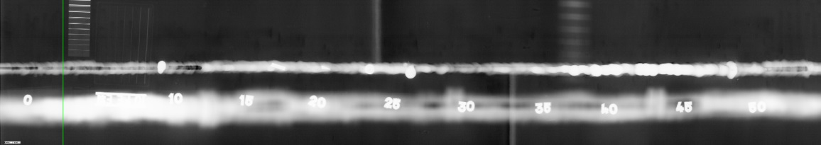
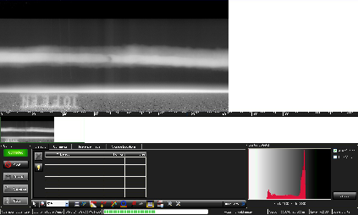
SIRIS – DIGITAL RT DNV QUALIFICATION
SAIPEM IMMEDIATE RADIOGRAPHY INSPECTION SYSTEM – WHAT IS IT?
SIRIS is the SAIPEM proprietary direct radiography system
Image acquisition, direct. special TDI (Time Delay Integration) detectors convert the absorbed radiation in digital image
Data processing. the RT data are immediatily processed providing “in real-time” digital image – no development/processing time. Radiographic images are sampled with a high frame-rate (up to 300 frame-rates per second
Data analysis. RT digital images interpreted “in real-time” with dedicated software with ad hoc algorithms for flaws sizing and verification of RT image quality requirements
  Double Wall Single Image (From 4 to 36 inch)
Single Wall Single Image (From 12 to 60 inch)
Pipe
Pipe
Standard DR Panel detector: large geometrical unsharpness
TDI Detector
TDI Detector
Siris TDI detector: limited geometrical unsharpness

Slide 3
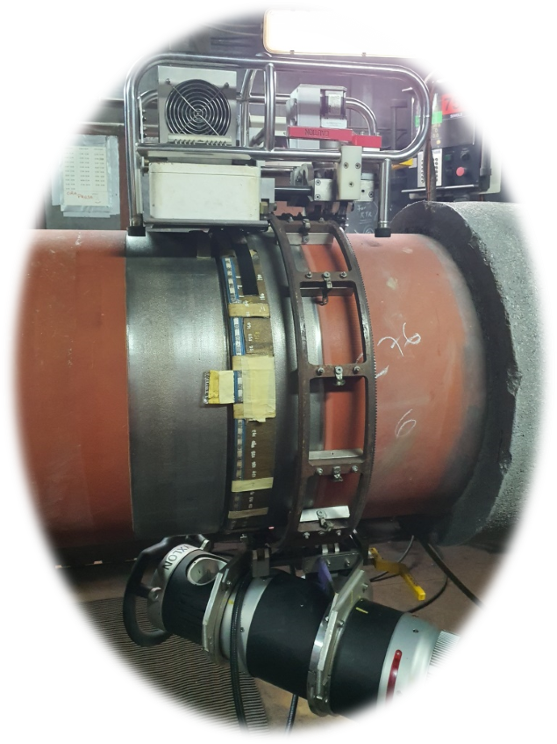
SAIPEM – SIRIS DNV QUALIFCATION
SIRIS – WHY AND WHEN
WHY TO USE IT
Quality of inspection. Fully compliant to DNV ST F-101, ISO 17636-2, API 1104 and ASME V
Quality of Inspection. Higher latitude of exposure >> no double exposure on dissimilar weld inspection
Quality of inspection. Automated digital tools for verification of RT image quality requirements (IQI, SNR, grey scale) >> objectivity, no human factor
Quality of inspection. Digital tools for flaws sizing >> Objectivity, no human factor, minimized interpretation disputes
Efficiency. Real-time Immediate results >> less 50% in inspection time
Digital data. Easier storage and sharing
Health and Safety. 20% less radiation and TOTAL elimination chemical products used for processing of RT film
Environment. Zero “CO2 footprint” in terms of archiving of radiographic images
WHEN SIRIS IS USED
Inspection of pipeline girth welds, as alternative to AUT or Convectional Radiography
Laboratory works, for example for welding procedure qualification
IRT (Intermediate Radiographic Testing). On CRA pipeline girth welds, upon customer requests, to inspect the root areas before weld completion

Slide 4
SAIPEM – SIRIS DNV QUALIFCATION
DNV QUALIFICATION - ACTIVITIES
The main objective of DNV qualification program was focused to document:
Equivalent performance of SIRIS compared with corresponding conventional film based radiographic testing (RT);
Documentation of performance, in terms of accuracy in length sizing, positioning, characterization, repeatability and detection compared with RT;
Practical trials, based on identification and evaluation of significant parameters and their variability;
An independent evaluation and endorsement of the SIRIS system as main volumetric methodology for the pipeline girth weld inspection.
Range of Validity
10 defective welds of different configurations in terms of material, weld, pipe wall thickness and diameter were prepared and used in the trials. The weld configurations included carbon steel and CRA materials, J and V bevel welds and partial and full welds. Pipe wall thicknesses were within the range of 10 mm to 31 mm, Pipe diameters were from 6” to 36” to cover a wider range. The qualification program was designed to equally cover application of both SWSI and DWSI techniques
Qualification Tests
The qualification tests consisted of many trials to document stability in scan results upon repeated scans, inaccurate guidance band settings, elevated temperatures, and to document equivalent sizing and detection performance as conventional film radiography.
Conclusion
SIRIS system can replace standard conventional film radiography for the pipeline girth weld inspection. Such achievement does not only represent a breakthrough in the radiographic quality performance but also provides for a significant enhancement in the pipeline installation market in terms of HSE (significantly reduced doses to operating personnel and no chemicals to be wasted) and cost reduction (due to reduced inspection times and lower manpower).

Slide 5
SAIPEM – SIRIS DNV QUALIFCATION
DNV QUALIFICATION – RESULTS/CONCLUSIONS
VALIDITY OF DNV QUALIFICATION
TECHNIQUES | DIAM | WT | MATERIALS | OTHER INFO
SWSI (Panoramic) DWSI (Directional) | 6’’ to 36’’ | Up to 31 mm | Carbon Steel and CRA | Full weld and Partial weld
TESTS PERFORMED
ITEM | PURPOSE | RESULTS ACHIEVED
Repeteability | Consistency of inspection performance, inspecting the same welds multiple times | Successful All observations were within the range of the mean value ±2σ for IQI and SNR
Band offset sensitivity | Document tolerances and insensitivity to inaccurate band setting on inspection results upon use of the scanner | Successful Band offset of ±5 mm has no impact on the inspection performance or the inspection capabilities.
Temperature sensitivity | To ensure that elevated temperatures will have no significant impact on the noise level of the digital detector. | Successful Elevated temperatures of <100°C have no significant impact on the inspection performance or the inspection capabilities
Detection; Sizing; Position capability | Target for the trial is to document equivalent performance in terms of detection, sizing, position for the SIRIS and the conventional film RT. | Successful The capabilities of characterization of weld imperfections are verified to be identical for the SIRIS and the conventional film RT records.
Source to Object Deviation | Reduction in minimum source-to-object distance of 50% for SWSI panoramic technique, provided that class B IQI requirements are fulfilled. | Successful The geometric unsharpness remains unchanged in the circumferential direction, and that the required detector side IQI sensitivity was achieved with source side positioned IQI’s with the Saipem SIRIS system.

