Slide 1
2023 IPLOCA CSR AWARD
SPIECAPAG INTECH
ECOLOGICAL BRICKS
Authors Name, Date, Location, Rev, Etc.

Slide 2
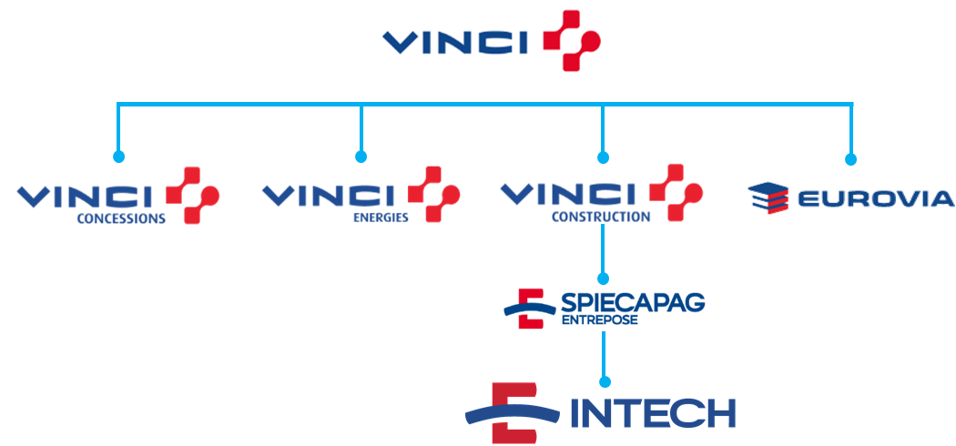
THE GROUP
In 2016, INTECH joined the VINCI group. The VINCI Group is the world's largest construction and concessions group.
In July 2020, the VINCI group was remolded and INTECH was allocated below Spiecapag. Spiecapag is a global leader in EPC pipeline design.
Currently, we have an amount of 300 employees allocated in 5 projects, besides central office and the Atibaia’s warehouse.
CERTIFICATION
INTECH is qualified and certificate in the standards:
NBR ISO 9001;
NBR ISO 14001;
NBR ISO 45001.

Slide 3
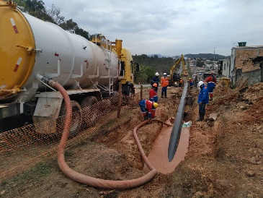
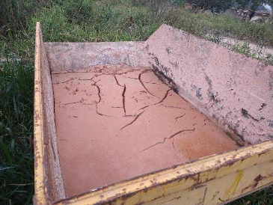
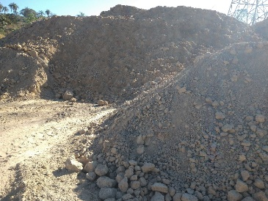
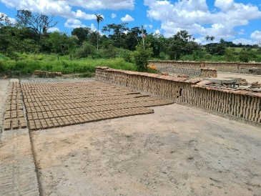
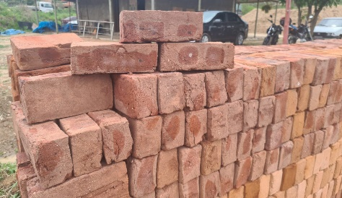
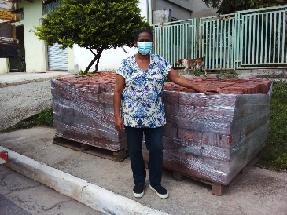
THE INITIATIVE
We used the mud that came out of the directional drilling process to produce bricks that we donate to a needy population nearby our project.
Thinking in reduce the useful life of landfills, the environmental pollution and our impact on the community near of our workplaces, we thought in this project. We developed all the calculation to make sure that Intech’s mud bricks are safe to use, we looked up for a partnership with a brick manufacturer to produce our bricks.
We sent to our partner the mud that was used on this project. He mixed clay with the mud, molded the bricks (adding water, if it was necessary), left the bricks under the sun to dry slowly and, after this steps, the bricks was taken to a kiln, to finish the process.

