Slide 1
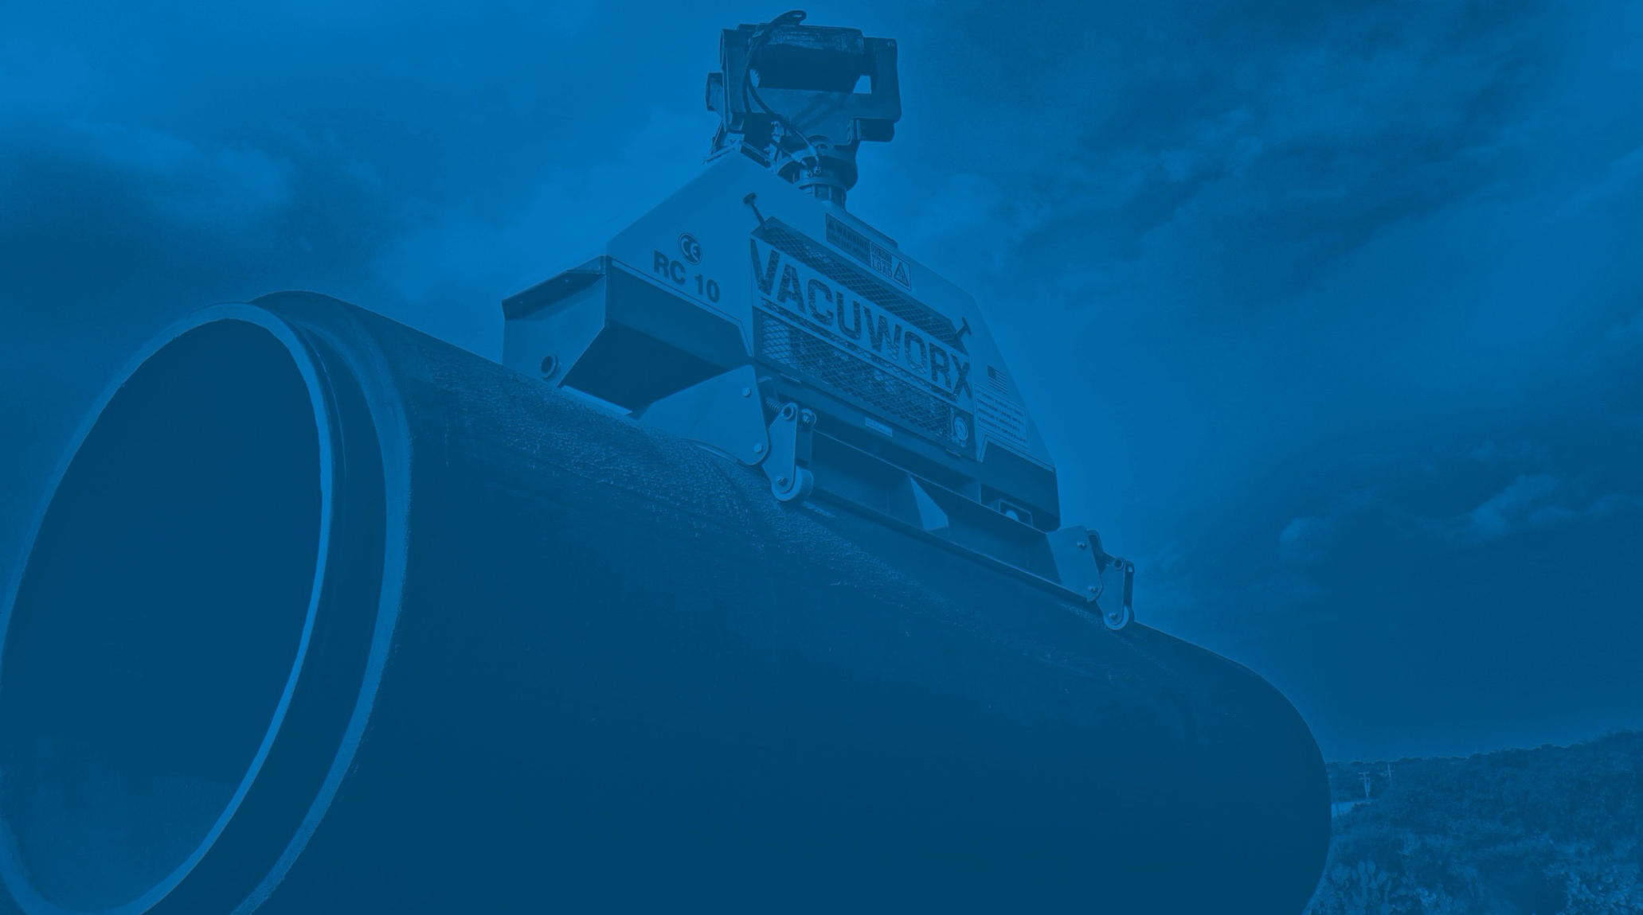
Vacuworx’s Commitment to Folds of Honor

Slide 2
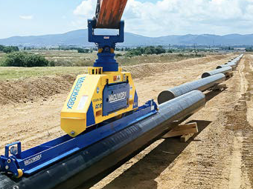
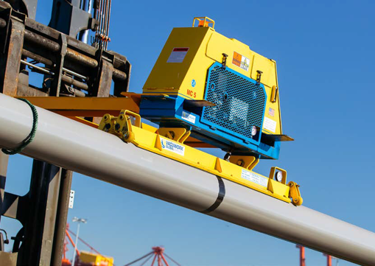
About Vacuworx
Since 1999, Vacuworx has been engineering and manufacturing the highest quality heavy-duty vacuum lifting systems, leading the world to a safer, more productive material handing environment in many industries.
Vacuworx has 55 employees who all share the same idea – people don’t belong in unsafe environments.
Safety is top priority in every aspect of the business. The company is proud to be ISO Standard 9001 certified for Quality Management Systems, and design all vacuum systems in accordance with the highest safety standards.

Slide 3
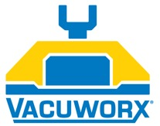
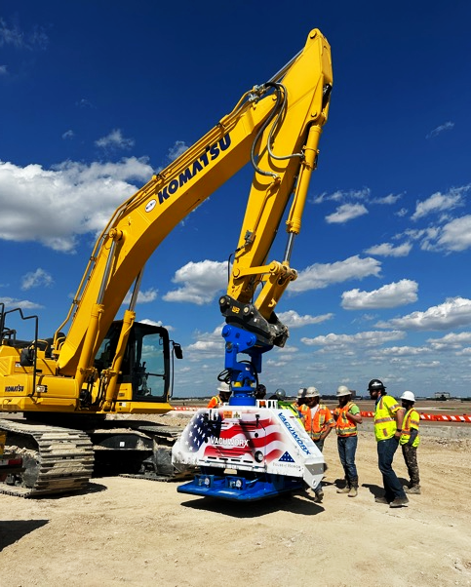
Findings and Solutions
FINDINGS
President of Vacuworx, Bill Solomon, recognized the lack of collaboration between the non-profit world and for-profit companies, and that many people are in unfortunate situations and are seeking resources to help improve their circumstances.
Folds of Honor provides educational scholarships to the spouses and children of military members who have fallen or been disabled while serving in the United States armed forces. They have awarded over 44,000 educational scholarships since 2007.
SOLUTIONS
Rental options continue to grow in popularity for Vacuworx customers, and shipping the same vacuum lifter to different customers over the course of many years increases exposure for Folds of Honor.
Vacuworx is pledging to donate a minimum of 10% of income from the RC 16 rental to Folds of Honor.

Slide 4
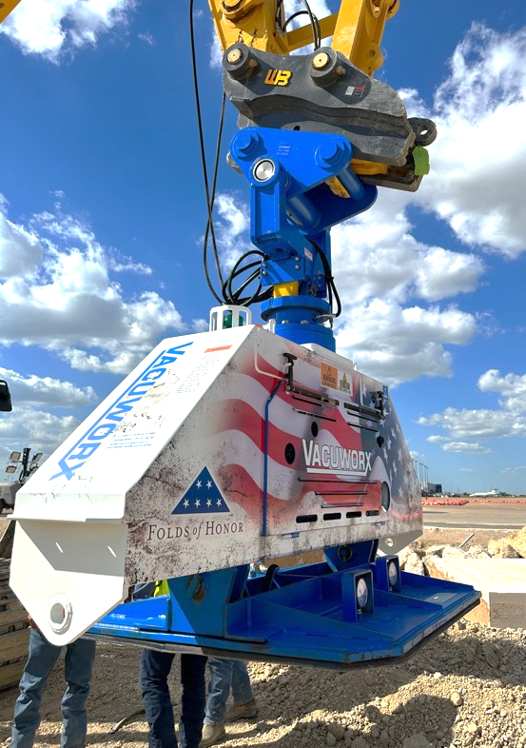
Implementation and Achievements
IMPLEMENTATION
Once communicated to staff, Vacuworx employees eagerly started working on designing a branded wrap for the RC 16 lifter that underwent many rounds of editing.
The lifter was built and decorated at the Vacuworx headquarters in Tulsa, Oklahoma, and was kept secret until completed.
ACHIEVEMENTS
The RC 16 Lifter was rented within the first week it became available.
Vacuum lifter is rented for months at a time, directly effecting the amount Vacuworx donates.
Customers are excited to operate a machine that provides more than safety on the jobsite, but an opportunity to support those in need.

Slide 5
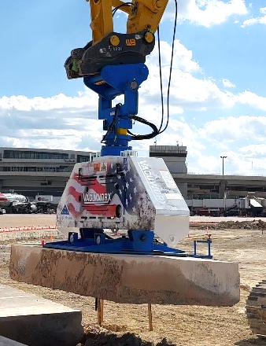
What’s Next
In 2009, Solomon founded the Eagle Gift Foundation, and has been involved with a variety of organizations through donations, partnerships and grassroots events. Through those relationships, Vacuworx plans to expand these special edition vacuum lifters by collaborating with other location, national, and global non-profits.
By expanding the company's philanthropic efforts and encouraging peers to jump onboard, Vacuworx will continue to help build synergy between the commercial sectors and non-profit companies.

